Slide 1
Jermyn Borough Council Meeting
2/17/22

Slide 2
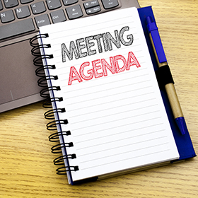
Meeting Agenda
February 17, 2022
• CALL TO ORDER
• PLEDGE OF ALLEGIANCE
• ROLL CALL
• PREVIOUS MEETING MINUTES
• TREASURER REPORT/BILLS PAYABLE
• CORRESPONDENCE
• PUBLIC COMMENT
• PROFESSIONAL REPORTS
POLICE
FIRE EMA
SOLICITOR
CODE ENFORCEMENT
ZONING
ENGINEER
TAX COLLECTOR
MAYOR
• COMMITTEE REPORTS/REALIGNMENT
• RUSHBROOK CREEK UPDATE-DENNIS KUTCH
• FOLLOW UP ON STOP LIGHT AT RUSH/WASHINGTON
• RENTAL MEMORANDUM OF UNDERSTANDING FOLLOW UP
• REGIONAL POLICE DISCUSSION

Slide 3
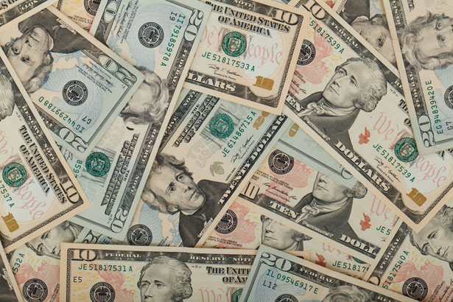
Treasurer’s report
2/17/22
ASSETS
Checking/Savings
Capital Reserve - DPW 10,725.94
Capital Reserve - Police 4,621.82
Crime Watch Fund 222.69
General Fund - Community 116,378.00
General Fund - FNB 4,505.77
Holiday Lights Fund 1,778.91

Slide 4
Treasurer’s report
Investment - General Fund 1,001.61
Investment - Liquid Fuels 33,816.66
Investment - Paving Fund 1,011.97
Investment - Recycling 5,003.80
Investment - Refuse 2,600.41
Liquid Fuels - FNB 6,903.50
Petty Cash 231.00
Recreations Fund 17,597.98
Recycling - Community 8,673.76
Refuse Checking - FNB 25,195.82
Total Checking/Savings 240,269.64

Slide 5
Treasurer’s report
200000 · Accounts Payable 30,046.21

Slide 6


